Slide 1
Autonomous
Unmanned Aerial Systems
Noel Rojas, Stephen Bakle, Nicholas Blum

Slide 2
Nicholas Blum
Mechanical and Hardware

Slide 3
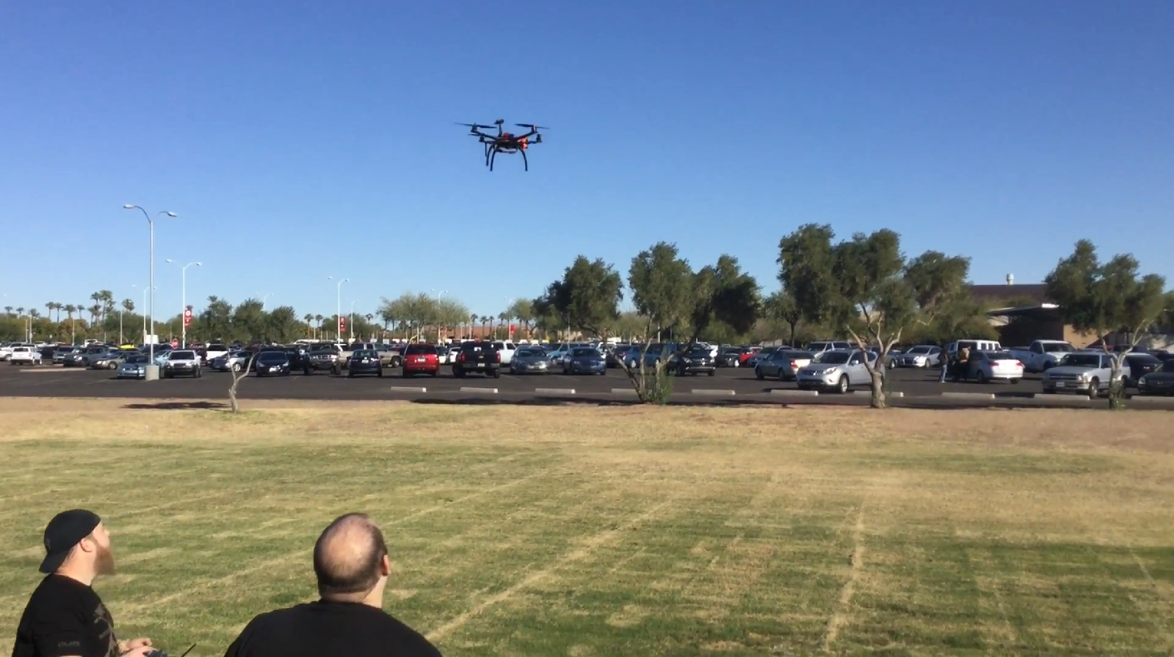
Goals
Notes:
Build a drone for campus public safety that can follow a predetermined path and change to manual mode on demand
The drone can transmit video and information to a ground station
Can have at least 10 minutes of flight
Has a range of at least 200 meters from the user

Slide 4
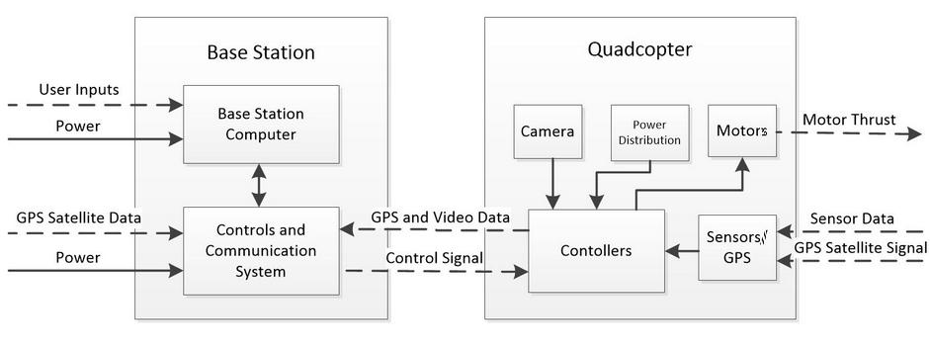
Systems for the Drone

Slide 5
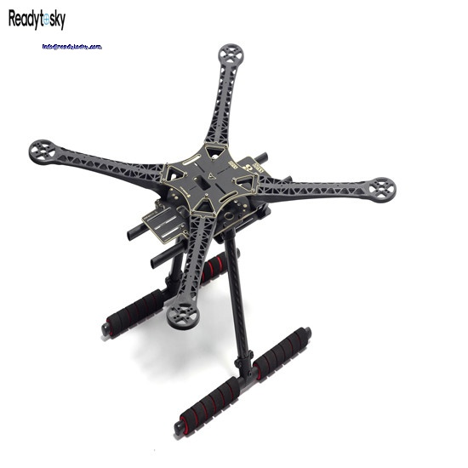
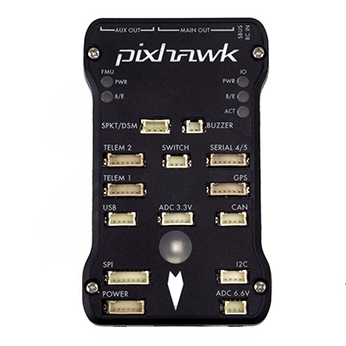
Design Process

Slide 6
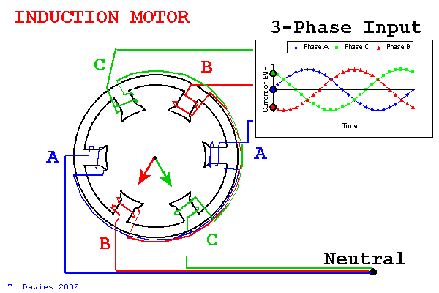
Motors

Slide 7
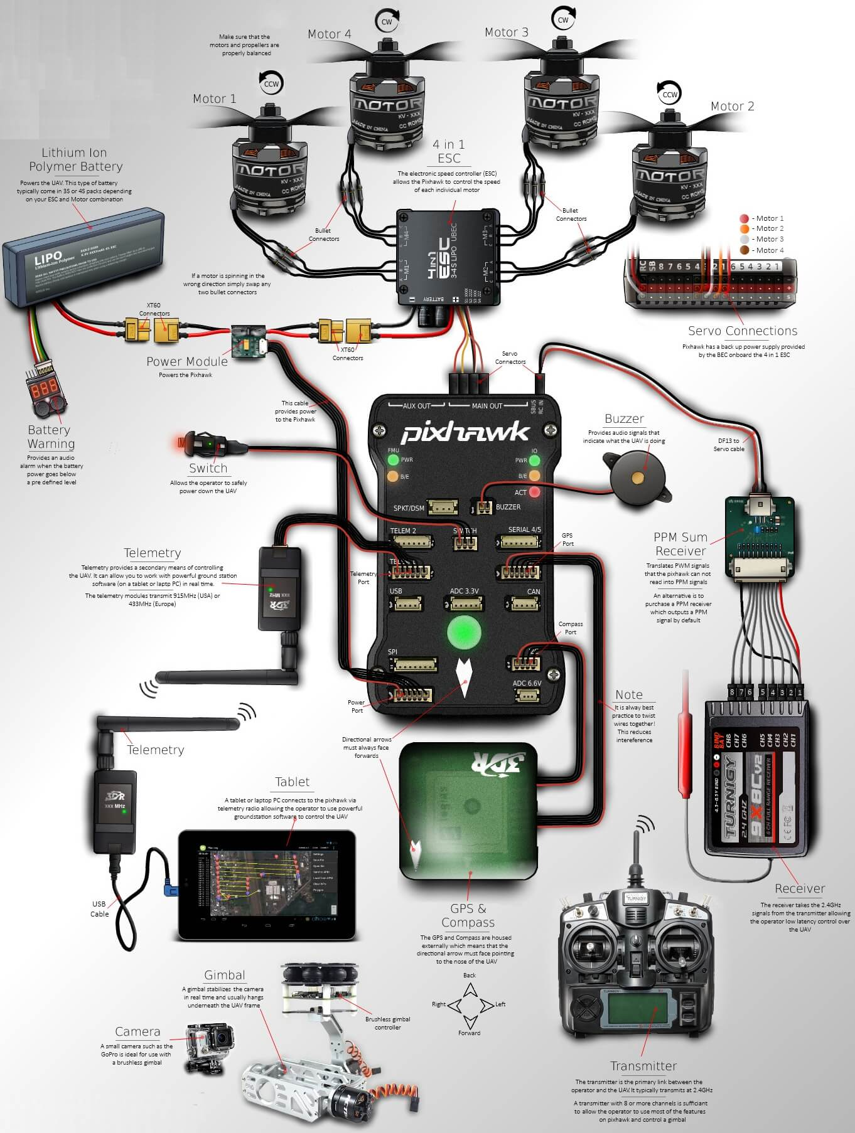
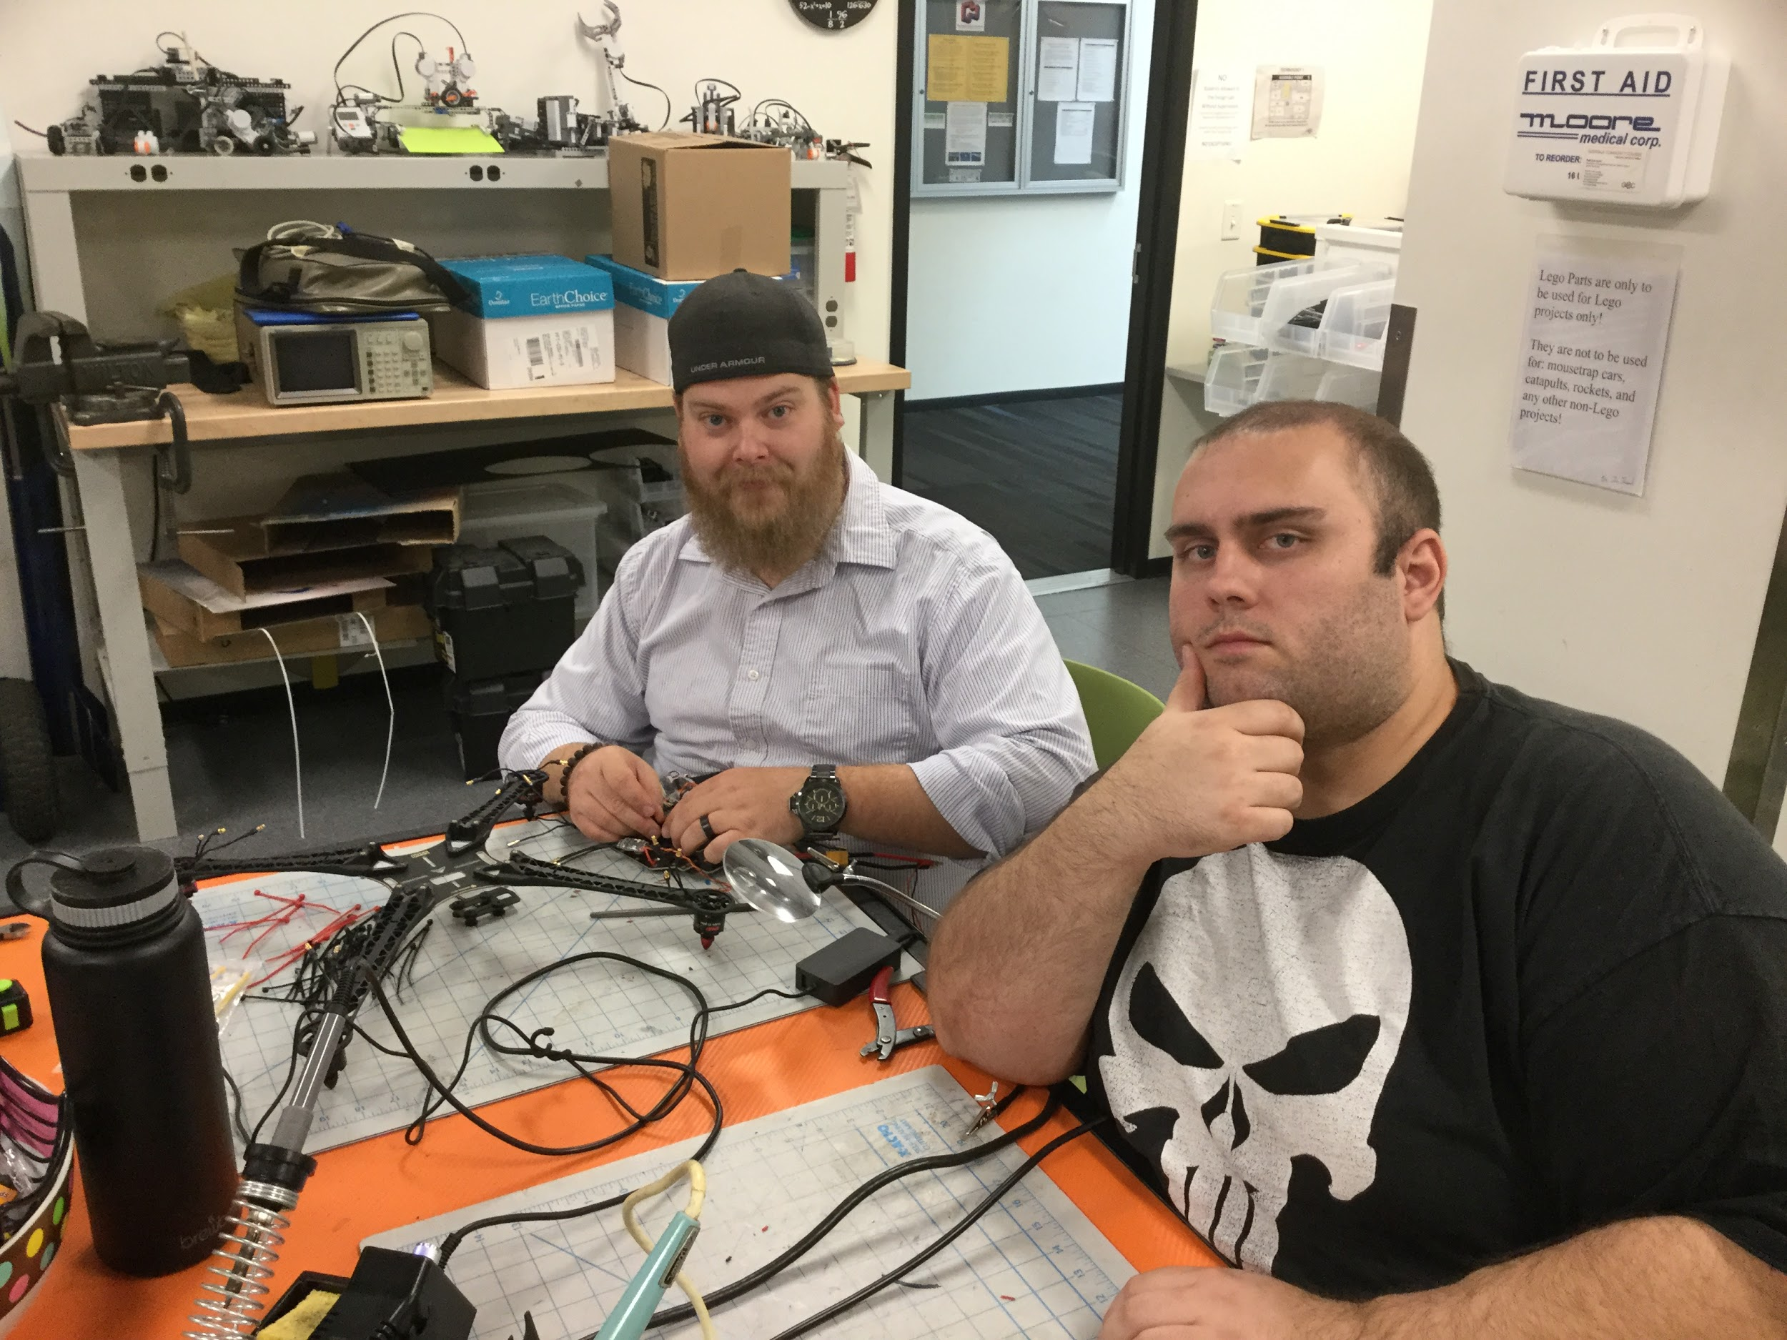
Assembly

Slide 8
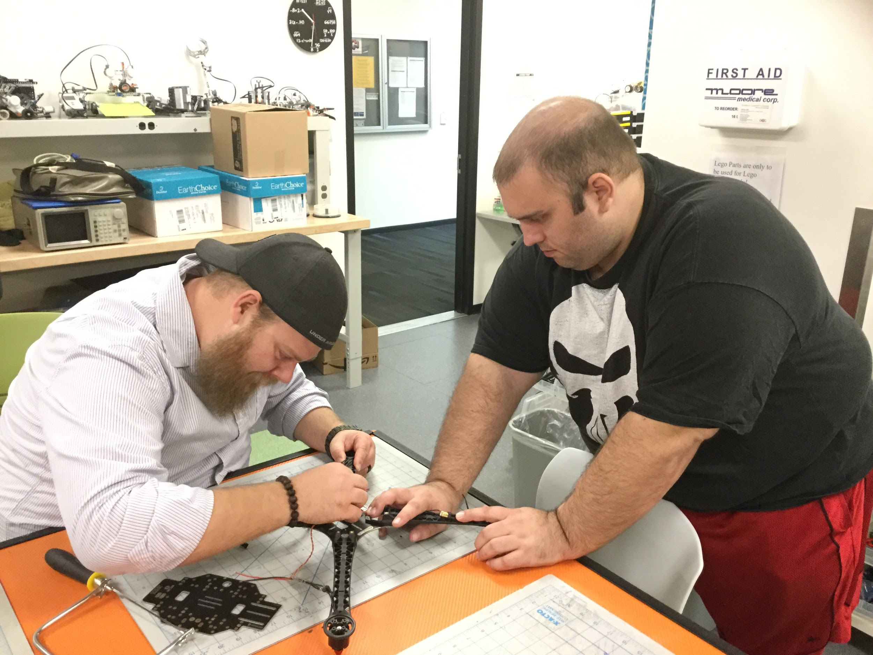
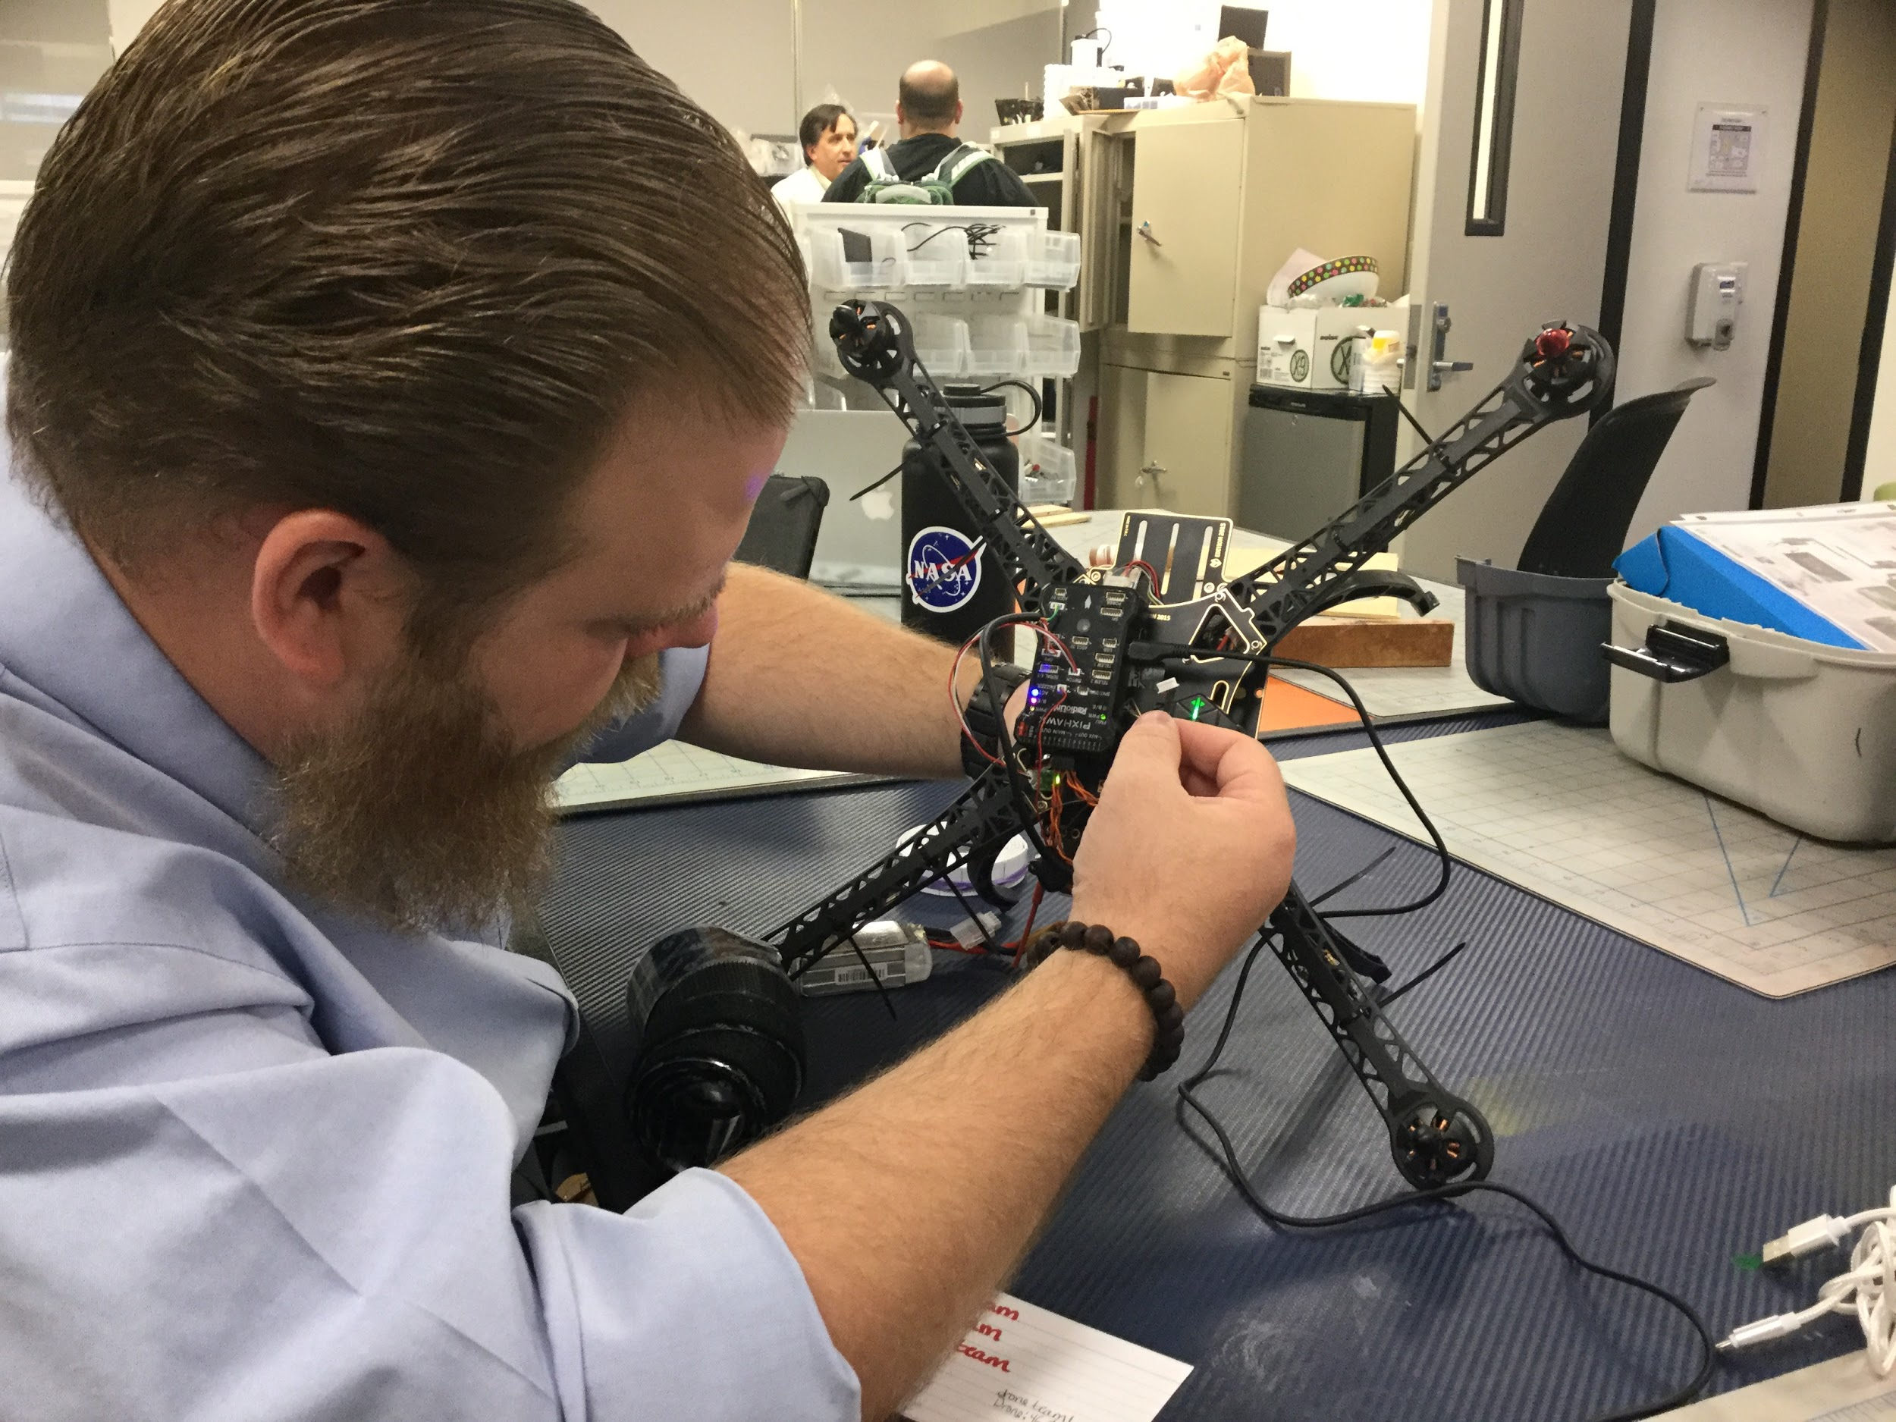

Slide 9
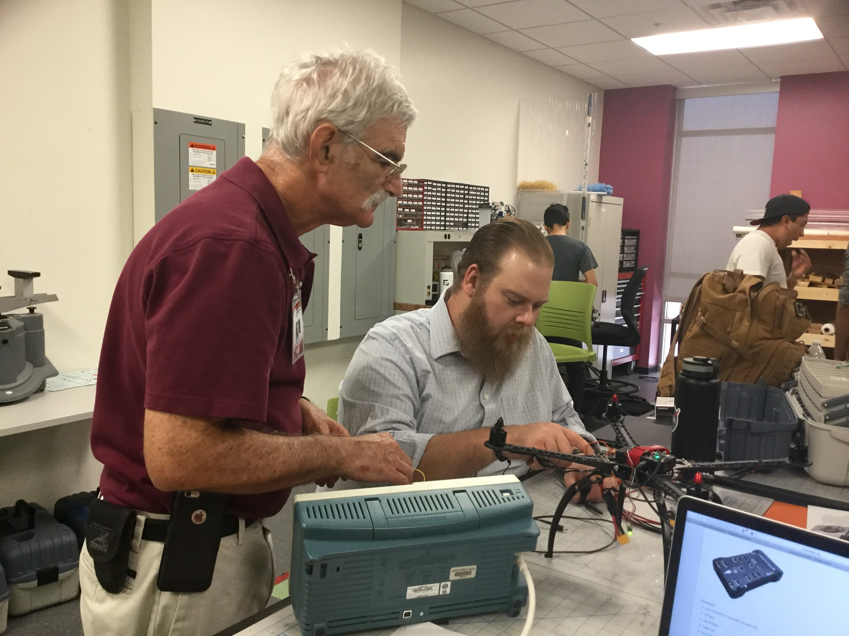
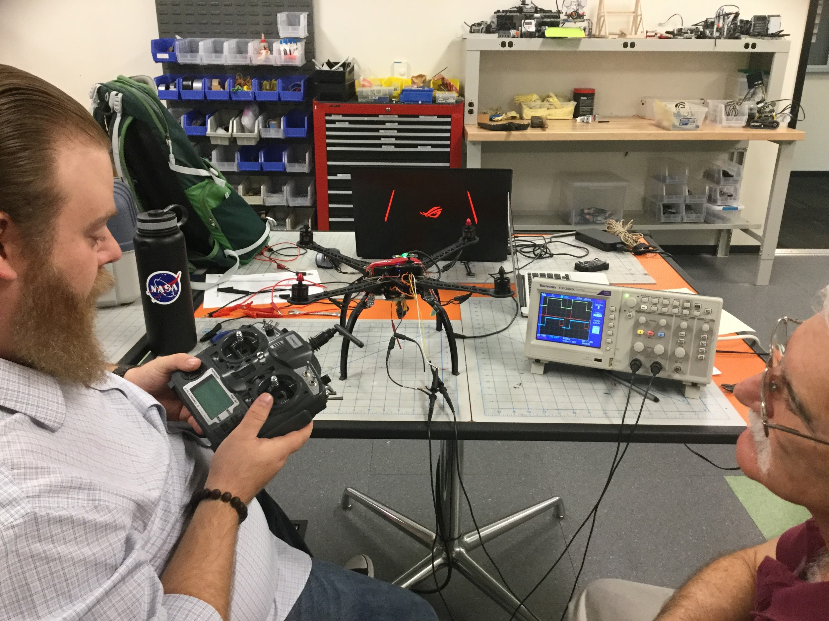
Troubleshooting
Notes:
There were several problems in the first design of the drone
The ESCs were not set up in the correct order so the drone always flipped
The ESCs were faulty as well, new batch had to be ordered
There was interference with the drone
It wobbled in the air
We used an oscilloscope to see the problems with the Pulse-Width Modulation(PWM)
The connections on the board caused interference which caused all these problems

Slide 10
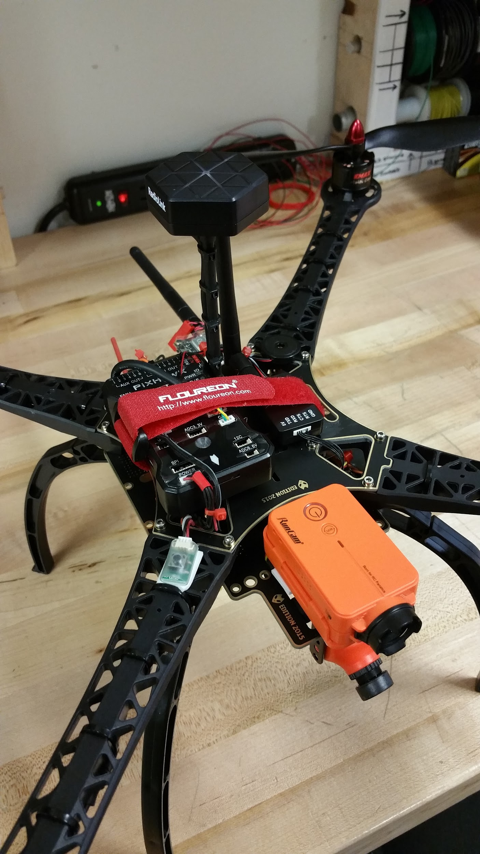
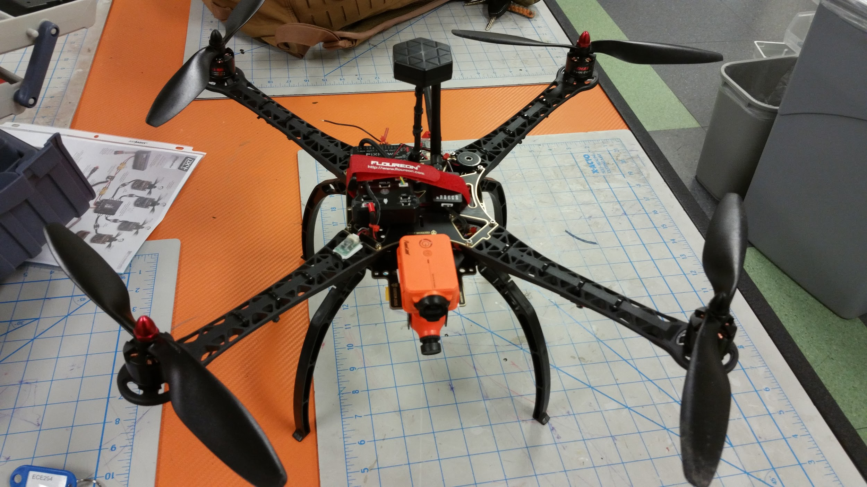

Slide 11
Noel Rojas
Telemetry and Transmission

Slide 12
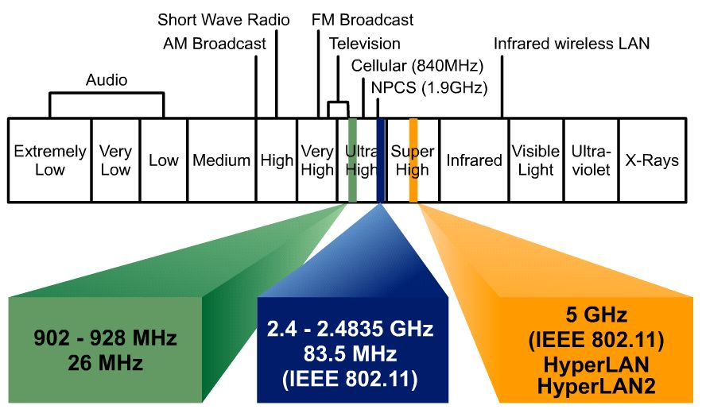
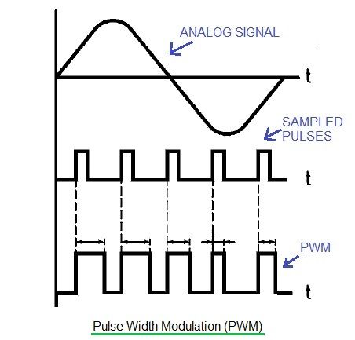
How it works
Transmitter creates EM waves in the Radio Spectrum
EM waves have their frequencies that determine their range
Radio Transmitter is in 2.4Ghz range
Longer the Wavelength, the longer the range
The receiver converts the analog signal into a digital signal that the flight controller understands

Slide 13
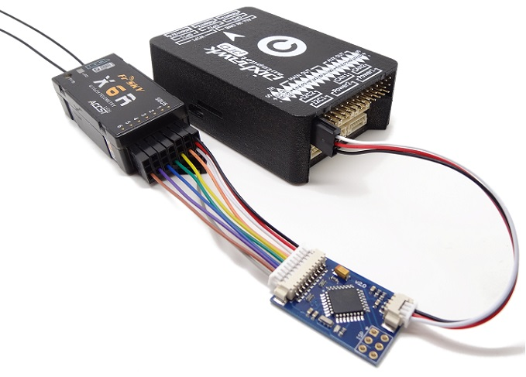

Slide 14
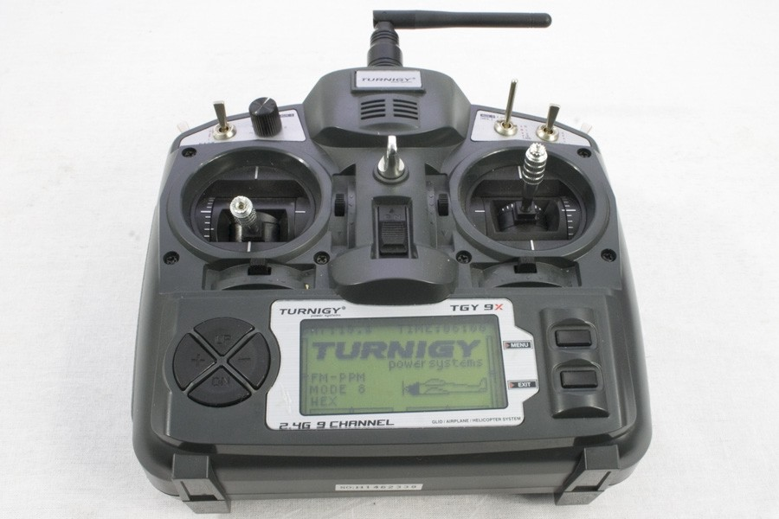
Setting up the Controller
GOAL - To set up various flight modes
Difficult
Different settings for every drone
The videos on youtube are outdated
Transmitters connected to Pixhawk flight controllers
Each transmitter has different firmware

Slide 15
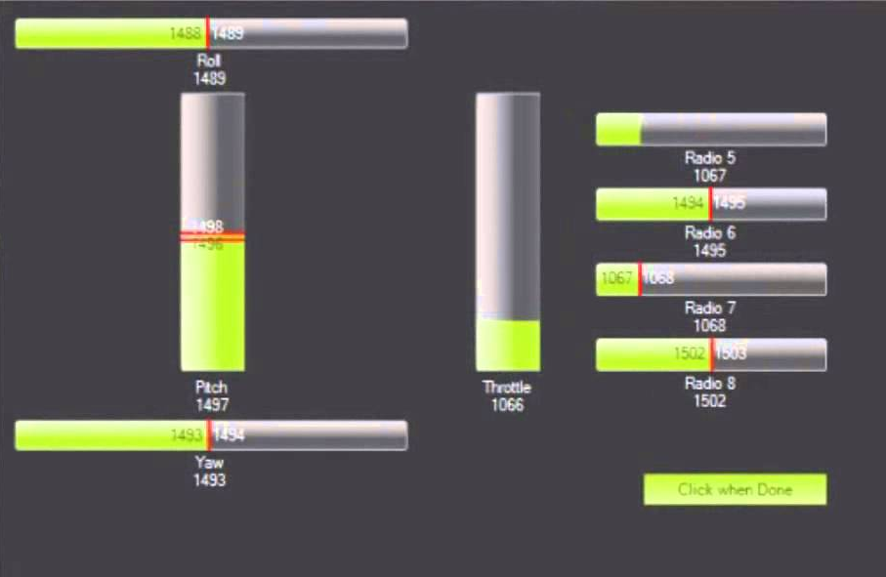
Mission Planner - Main Channels

Slide 16
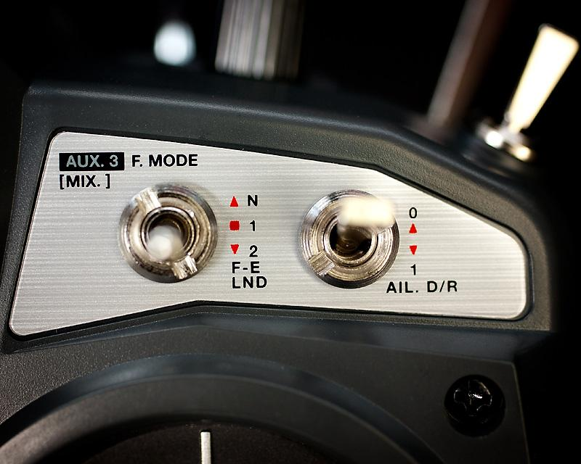
Main Channel
Sub Channel

Slide 17
Configuring Flight Modes

Slide 18
Problems - Radio
It took a week of observations and trial and error
Changes seemed right on software but there were problems with
Internet recommendation was to open the transmitter and modify the hardware
Easier solution is to swap the bands
WORKED!!!

Slide 19
Stephen Bakle
Software
Notes:
Hi, my name is jeff and was put in charge of software. Going into this project, being told I was going to do software, I imagined I was going to be writing some code. That's not how it went though, the team was advised early on that programming a drone just to fly from scratch would take too long and take away from the actual goal of the project to create a quadcopter capable of automation. Taking the recommendation of our instructor, Dr Frank, it was decided that the program called Mission Planner would be the brains of our project.

Slide 20
P.I.D.

Slide 21
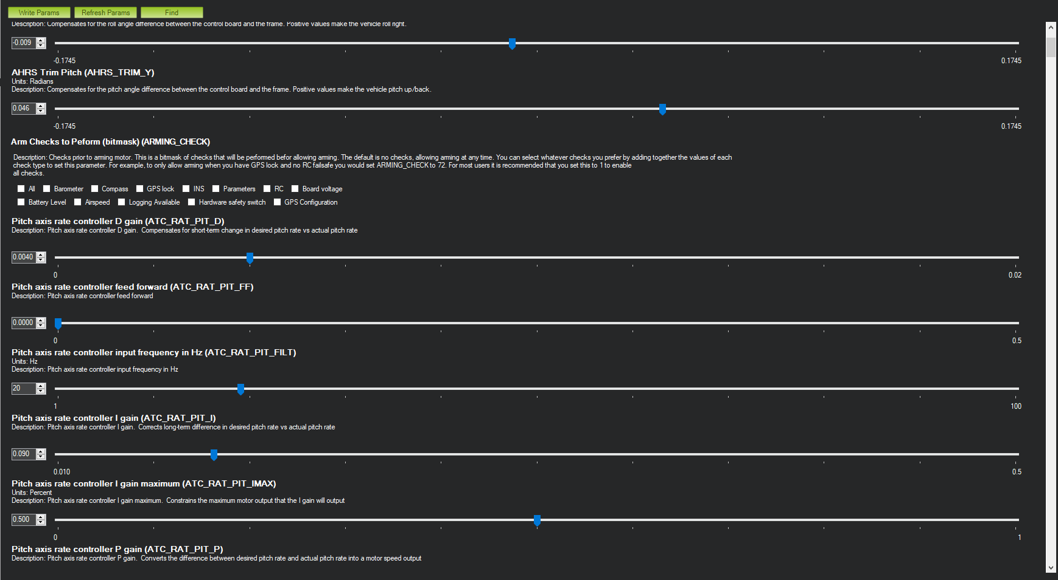
Parameters
Notes:
The initial setup wizard is just the very beginning of settings we can configure. There are hundreds of different parameters we can edit to get the drone to behave exactly how we want. An example is that to arm the drone, a certain set of requirements need to met unless you go into the parameter list and tell it to ignore those requirements. Its specific enough that you can tell ti to ignore 1, 2, or all of the requirements before arming.

Slide 22
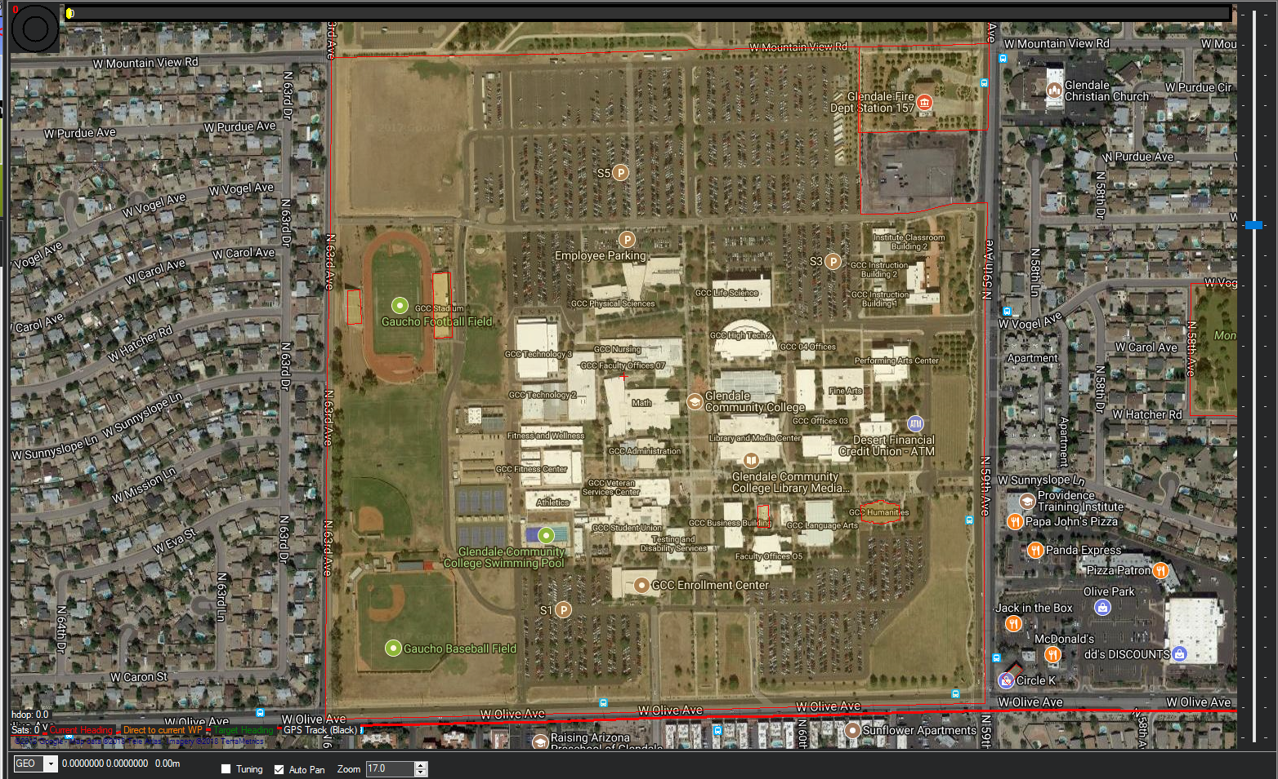
Flight Map
Notes:
Mission planner comes with access to google maps and will show the drones gps position. It also has a color code showing where you can legally fly the drone. Youll see that our campus, GCC, has a yellow tinge and that means it is possible that flying a drone here is prohibited. If you are too close to an airport, a hospital, or any other place with a helicopter landing pad it will show the area being highlighted in red. This shows that it is not legal to fly your drone in area.

Slide 23
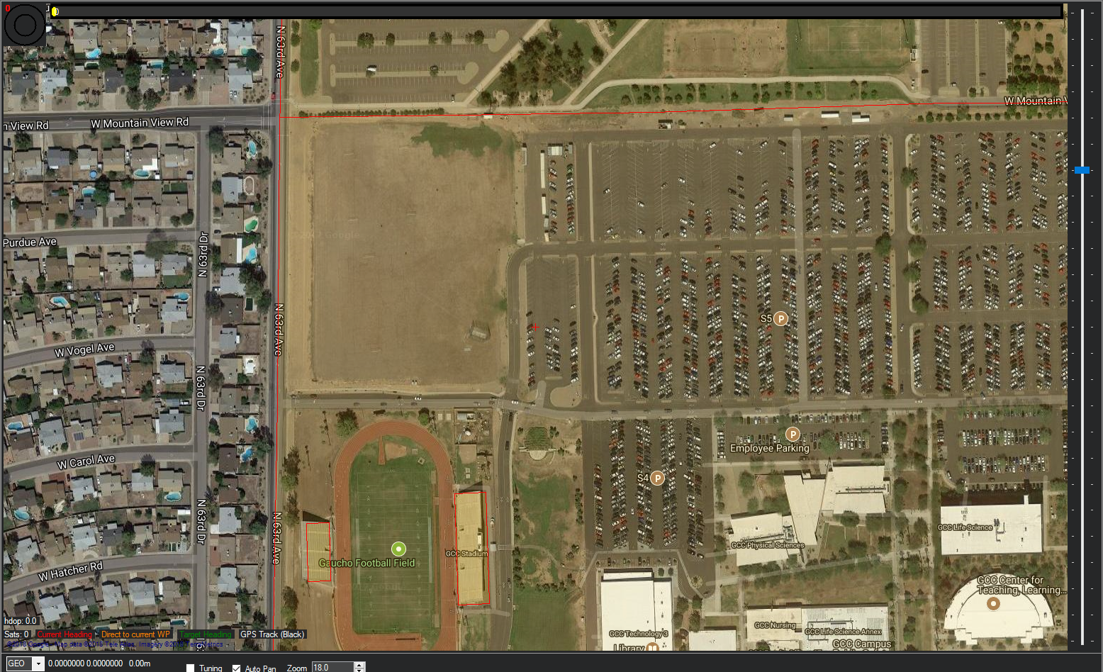
Flight Map
Notes:
Youll see here that we can get quite a bit of detail from the map, here we see the individual cars parked in our schools parking lot. The field shown here is where we practiced flying or drone.

Slide 24
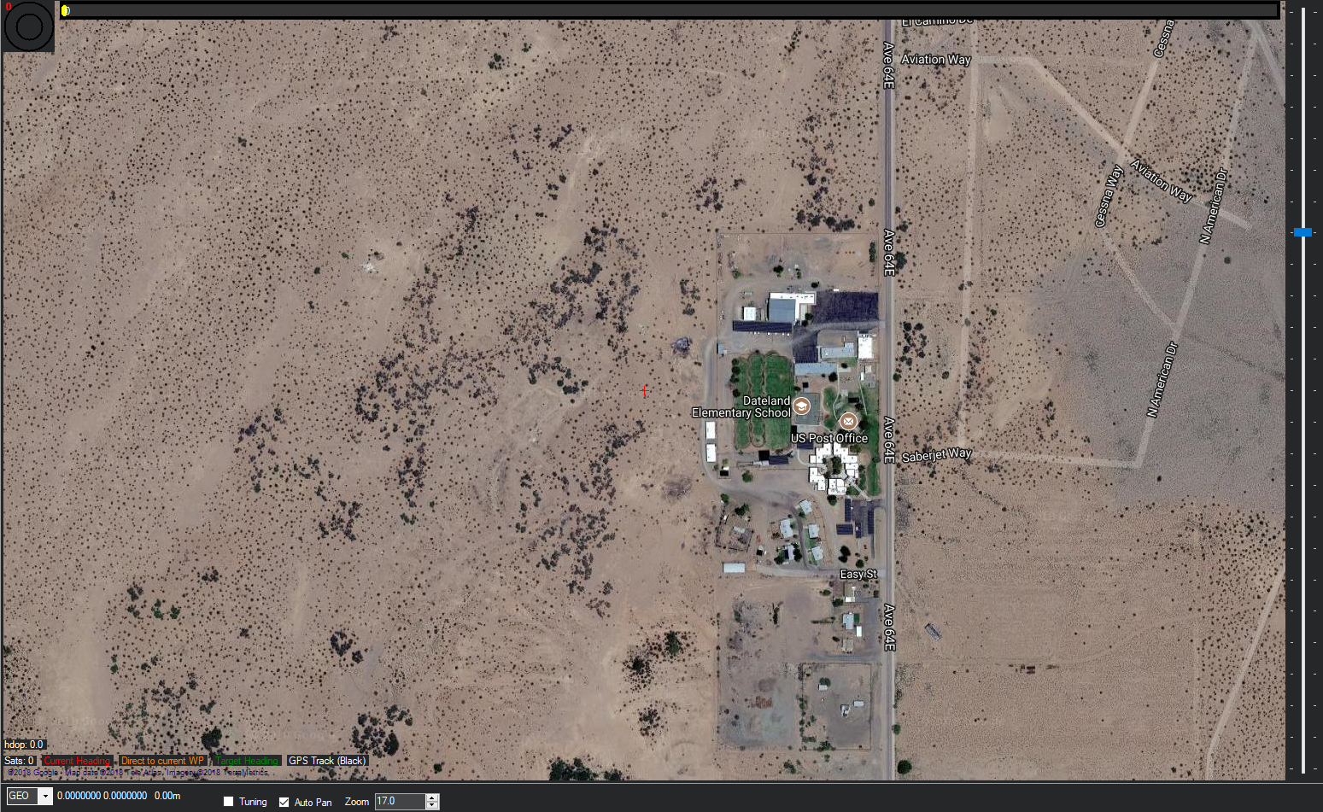
Terrain Map without Data Access
Notes:
We really wanted to do a demonstration of our drone while the ANSR helpers were filling the balloon. What we found out was that unless loaded ahead of time, its hard to get the map zoomed in enough to plan a flight with out internet.

Slide 25
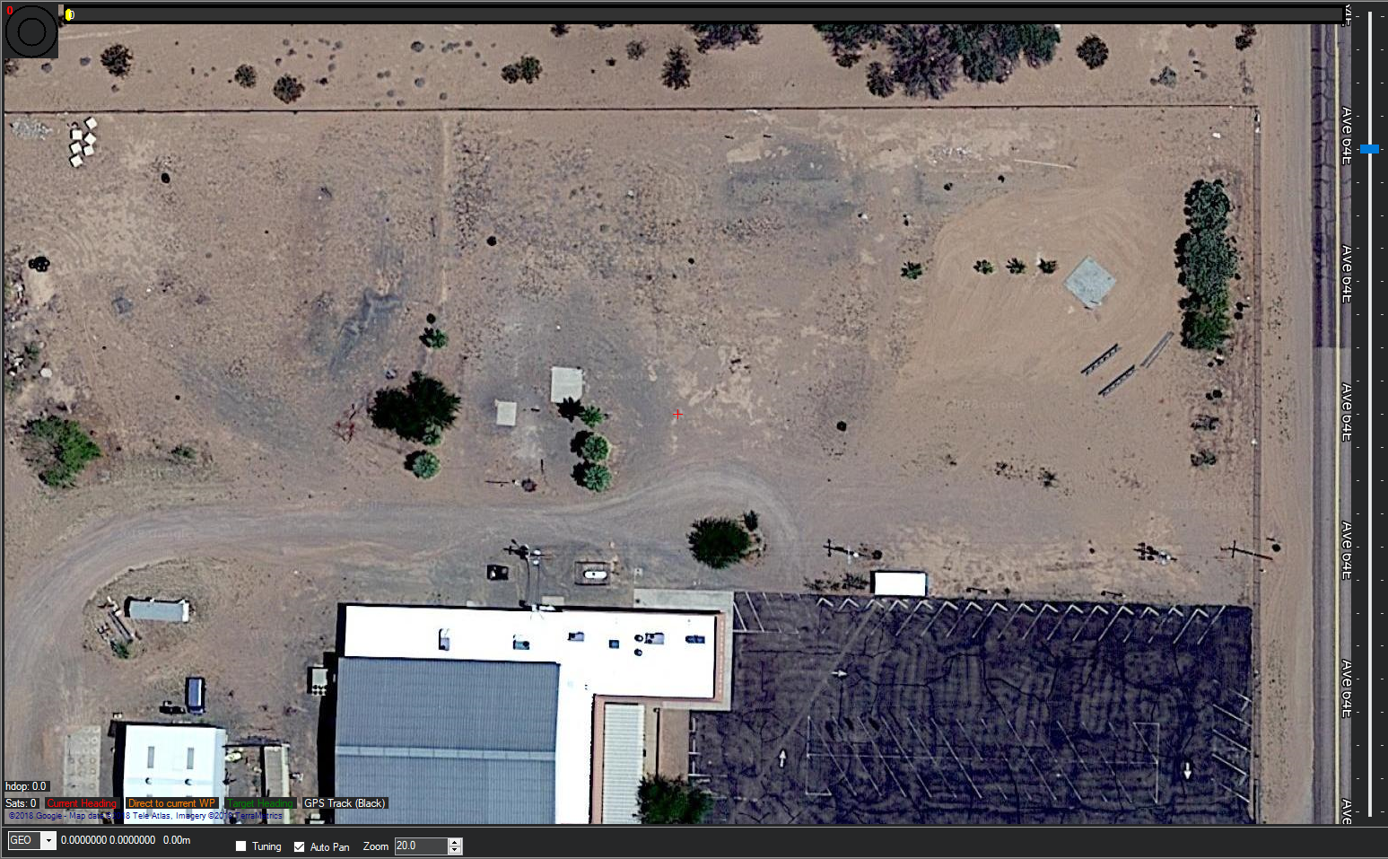
Terrain Map with Data Access
Notes:
Here is the detail that would of let us judge distances better so we could properly plan the flight. Youll see from the previous map that this one had a lot more detail. Infact when we were trying to plot the drones course on site, the map we had access to didnt even show a tower that was in the field.

Slide 26
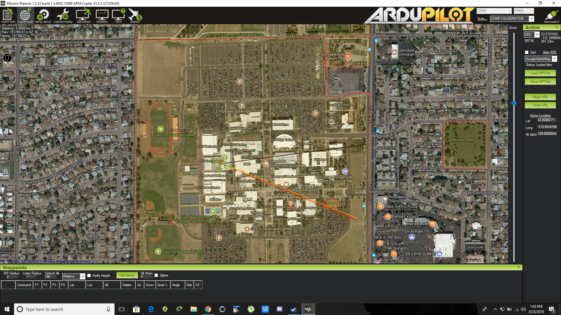
Waypoint Planning for Automation
Notes:
Finally we come to the interface for adding waypoints for the automated flight. Youll see the little green quadcoptor icon and how it shows its position and even which direction its facing.

Slide 27
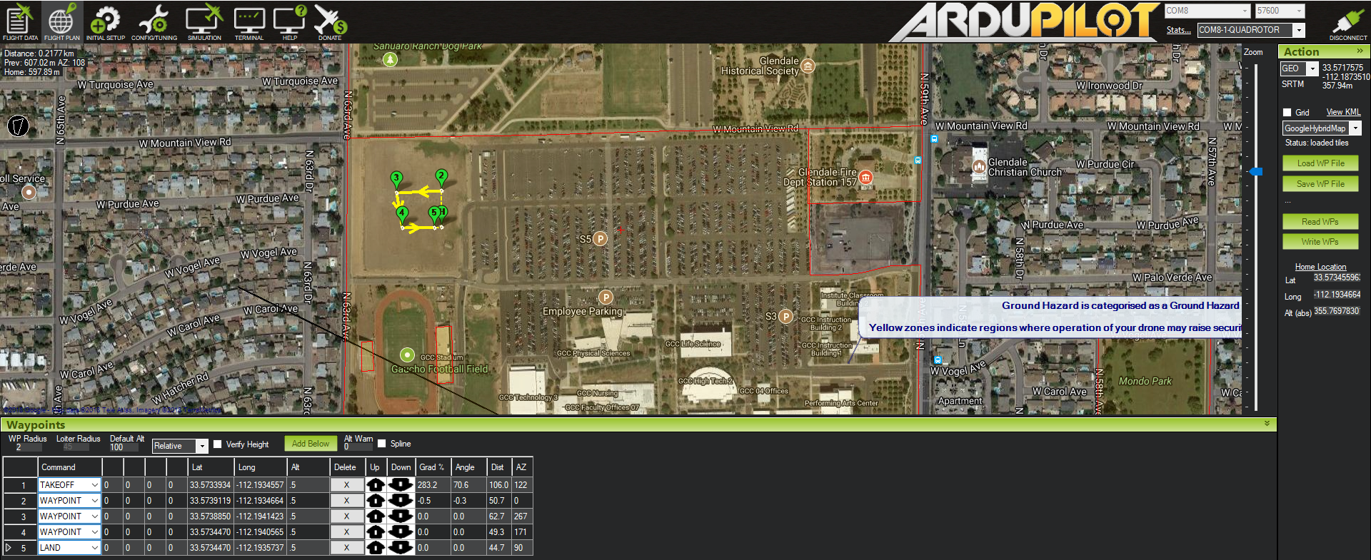
Waypoint Planning for Automation
Notes:
Planning the way points take a little planning, if you are launching from a landed position your first waypoint needs to be a take off command. Once it takes off it will go to each waypoint in numerical order until you tell it to land. Youll see here that it takes off, then goes to waypoint 2, 3, 4, and finally lands at 5.

Slide 28
Thank You

